Slide 1
Automatic Colorization Using Deep Learning
Raghav Jindal (1501CS36)

Slide 2
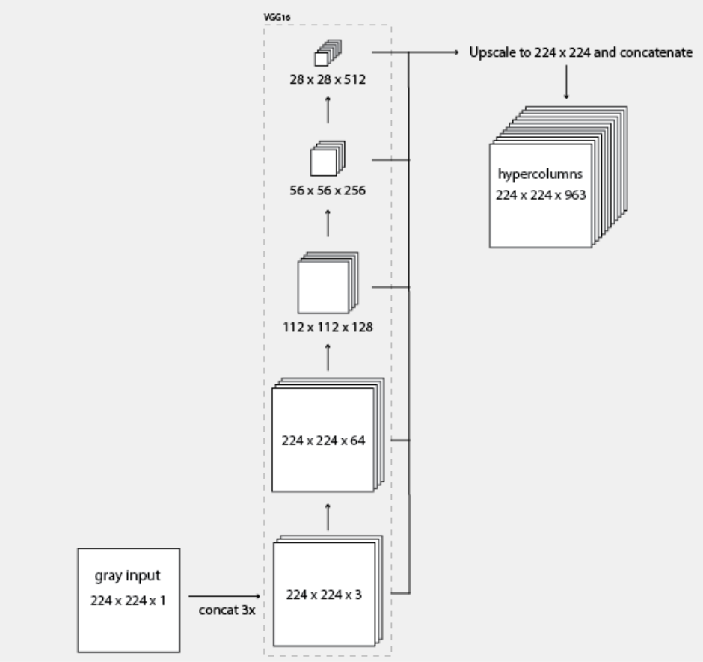
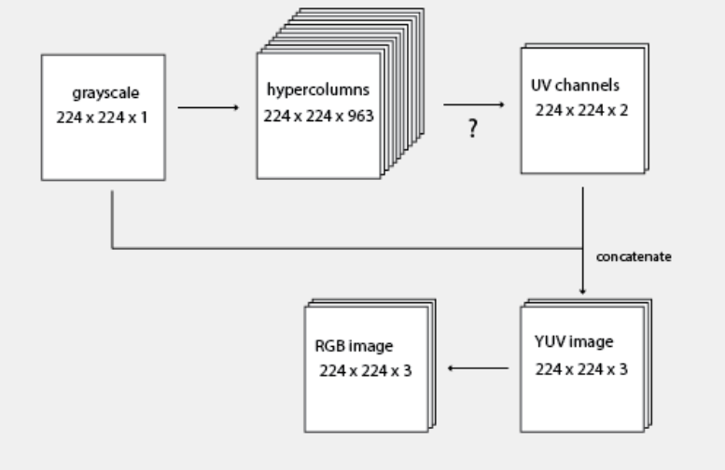
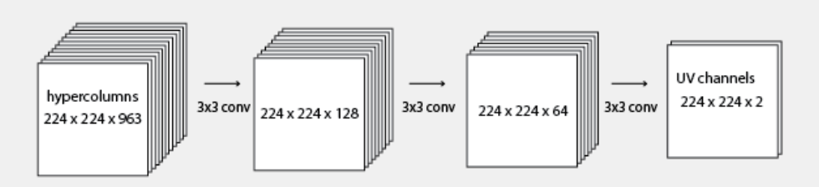
Last Seminar ...
Used CNN + Hypercolumns
YUV format of image used instead of RGB
1)
2)
3)

Slide 3
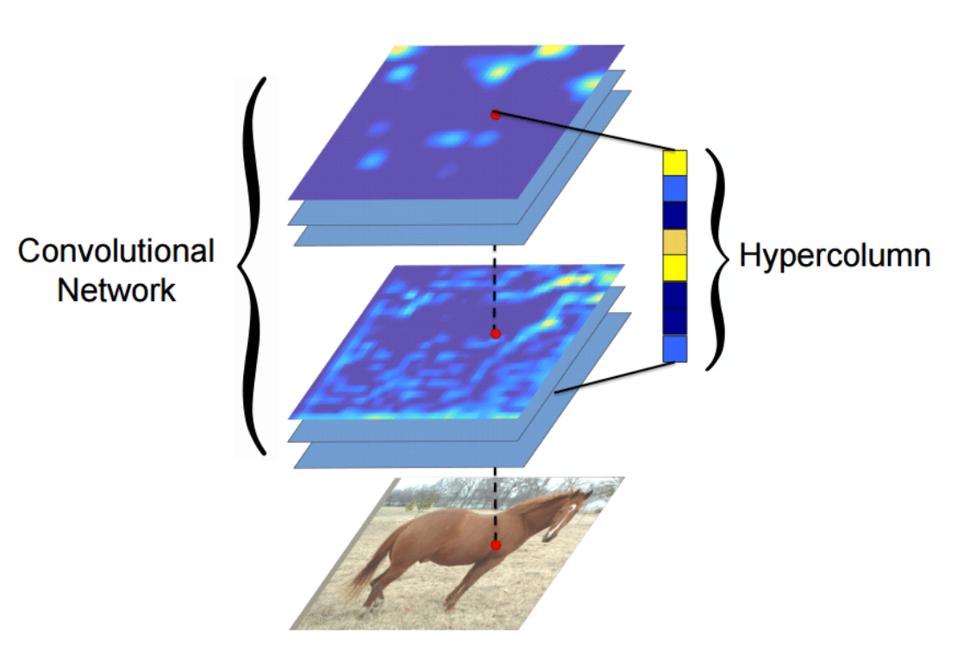
Hypercolumn
Definition: A hypercolumn for a pixel in the input image is a vector of all the activations above that pixel
Info in last FC layer: too coarse spatially
In the initial layers: spatially precise info but lack semantic info
Hypercolumns-> Best of both worlds
Q) What to do if size of feature map smaller than input image?
Ans: Bilinear interpolation
Notes:
the information in the last FC layer may be too coarse spatially to allow precise localization (due to sequences of maxpooling, etc.), on the other side, the first layers may be spatially precise but will lack semantic information. To get the best of both worlds, the authors of the hypercolumn

Slide 4
Problems
Used a MSE(form of L2 norm) as objective function
G. Larsson et al : Learning representations for automatic colorization. Showed L2 loss produces blurry results. Intuition: “averaging possibilities”
Notes:
L2 norm: Square root of the square of difference in the pixel values of the generated input and the actual input.Imagine a network who's task is to predict a coin flip. Between heads (0.0) and tails (1.0)
A standard l2 loss will cause the network to always predict 0.5, since that minimises error.
An adversarial network will predict either 1.0 or 0.0 to try to match the probability distribution of the real network

Slide 5
For CNN : lot of effort to design effective loss function
It would be highly desirable if we could instead specify only a high-level goal, like “make the output indistinguishable from reality”, and then automatically learn a loss function appropriate for satisfying this goal.
.
Notes:
If we take a naive approach, and ask the CNN to minimize Euclidean distance between predicted and ground truth pixels, it will tend to produce blurry result. Coming up with
loss functions that force the CNN to do what we really want
– e.g., output sharp, realistic images

Slide 6

ENTER GENERATIVE ADVERSARIAL NETWORKS : Consists of “Generator” and “Discriminator”

Slide 7
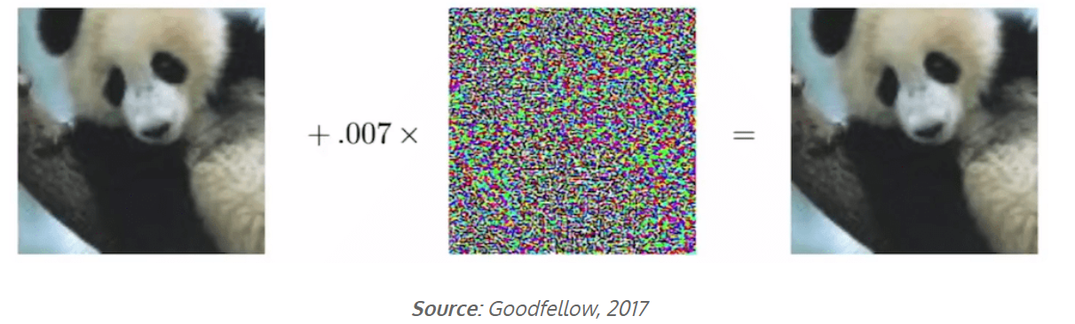
Jargons...
Generative model: take a collection of training examples and form a representation of their probability distribution.
Adversarial Examples: given an image classifier, example which fools the network.
Gibbon
Panda

Slide 8
Adversarial attack
image classifier is essentially a complex decision boundary in a high-dimensional space
start adding random noise to the image and keep it very close to zero.
Keep on doing so until the image shifts to the “other side”
Notes:
We can achieve that by controlling L2 norm of the noise.

Slide 9
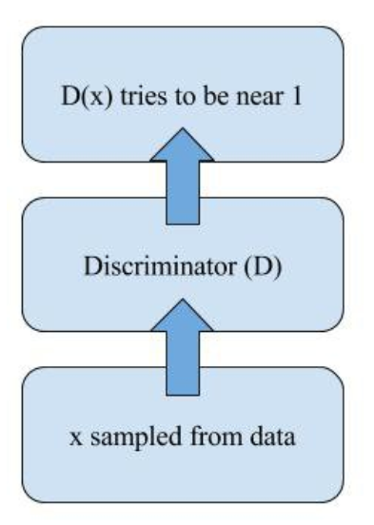
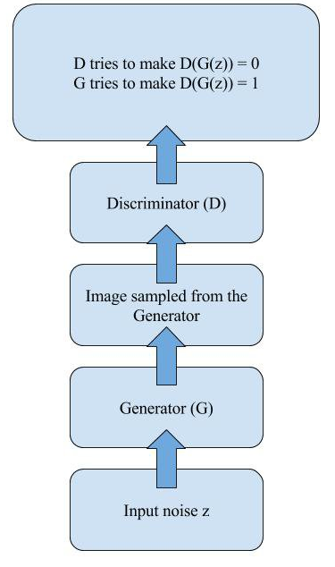
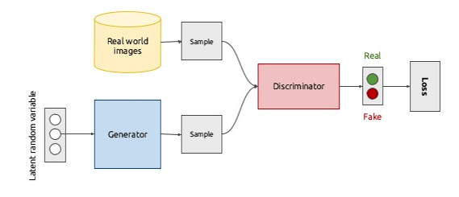
Generator & Discriminator
Discriminator: Instead of image classifier, classifies if “real” or “fake”
Generator: Network that learns to generate fake images from random noise that Discriminator would misclassify as “real”.
Discriminator
GAN architecture
Generator

Slide 10
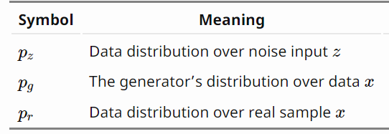
The math for the objective function...

Slide 11
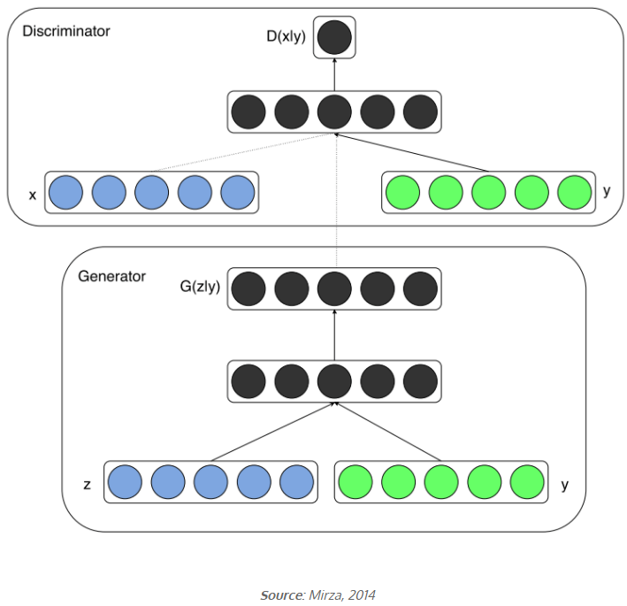
CGANs
Simple Trick: if you have labels for some data points, you can use them to help the network build salient representations
Notes:
Let’s say your model can generate all kinds of animals, but you are really fond of cats. Instead of passing generated noise into the Generator and hoping for the best, you add a few labels to the second input, for example as the id of a class cat or just as word vectors

Slide 12


Obj function of paper
Optimisation: alternate one gradient descent on D and one on G. Use minibatch Gradient Descent
Notes:
Generator : not only fool the discriminator, the generator is tasked to not only fool the discriminator but
also to be near the ground truth output in an L2 sense

Slide 13
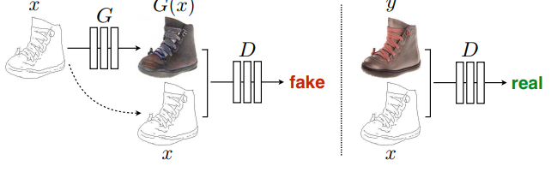
Architecture
Same architecture could be used for any image translation problem: translating one possible representation of a scene into another

Slide 14
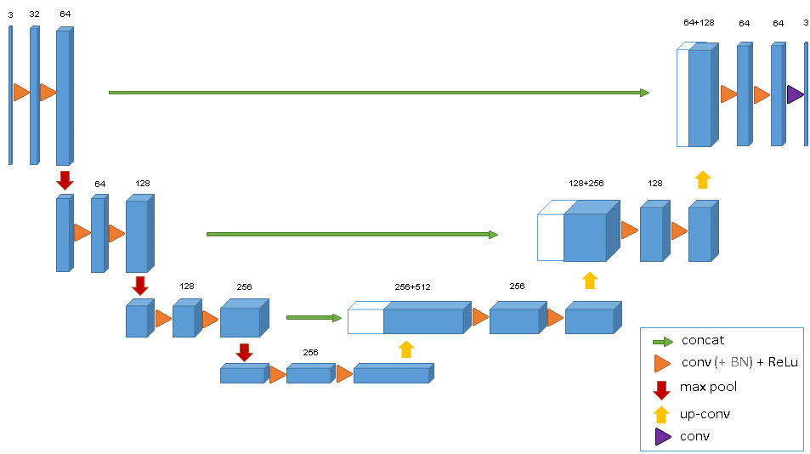
Architecture
Both generator and discriminator use modules of the form convolution-BatchNorm-ReLu
For many image translation problems, there is a great deal of low-level information shared between the input and output, and it would be desirable to shuttle this information directly across the network.
So, SKIP CONNECTIONS USED in Generator

Slide 15
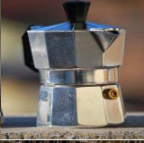
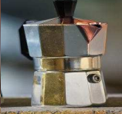
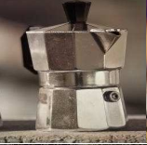
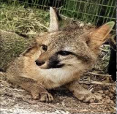
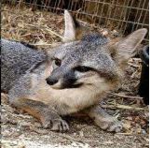
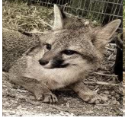
Evaluation Metric
No particular evaluation metric is available. Plausibility to a human observer is often the ultimate goal.
From paper
Ground Truth
Previous paper

Slide 16
THANK YOU

